Slide 1


Model Training and Improvement
How to train your model
Yordan Darakchiev
Technical Trainer
iordan93@gmail.com

Slide 2
sli.do #MachineLearning

Slide 3
Table of Contents
Bias – variance tradeoff
Applying regularization
Training and testing
Cross-validation
Model tuning and selection
Feature selection, feature engineering

Slide 4
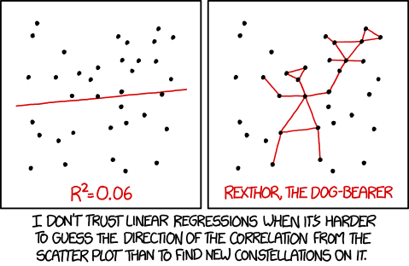
Before We Start…

Slide 5
Regularization
Taming your model

Slide 6
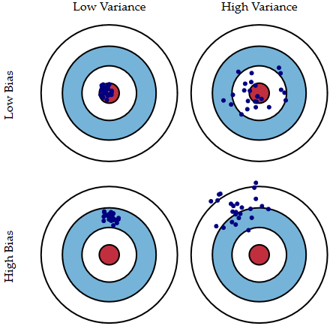
Bias-Variance Tradeoff
When we fit models, we have two main sources of errors
Bias – how far are the predicted from the actual values
Variance – variability of prediction for a certain data point
Illustration – shooter aimed at a bullseye target
High bias – the aim is shifted away from the center
High variance – the points are more "spread out"

Slide 7
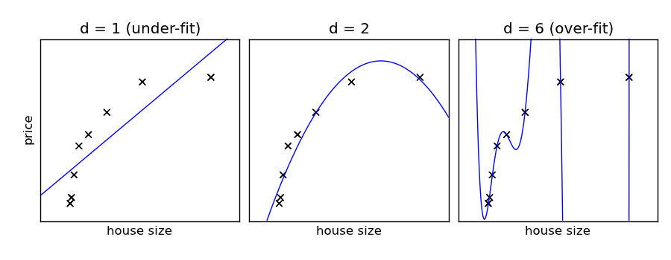
Bias-Variance Tradeoff (2)
When we fit several models, they perform differently
Some are not complex enough (don't describe data well enough)
Underfitting (high bias)
Some may describe the data "too well" and fail to generalize when new data points are introduced
Overfitting (high variance)
Optimal model: tradeoff between underfitting and overfitting
Usually underfitting is easy to spot
Poor performance w.r.t. some metric
Overfitting is more complicated
Many methods exist to prevent overfitting

Slide 8
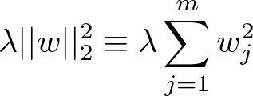
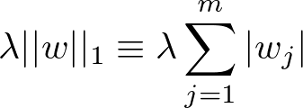
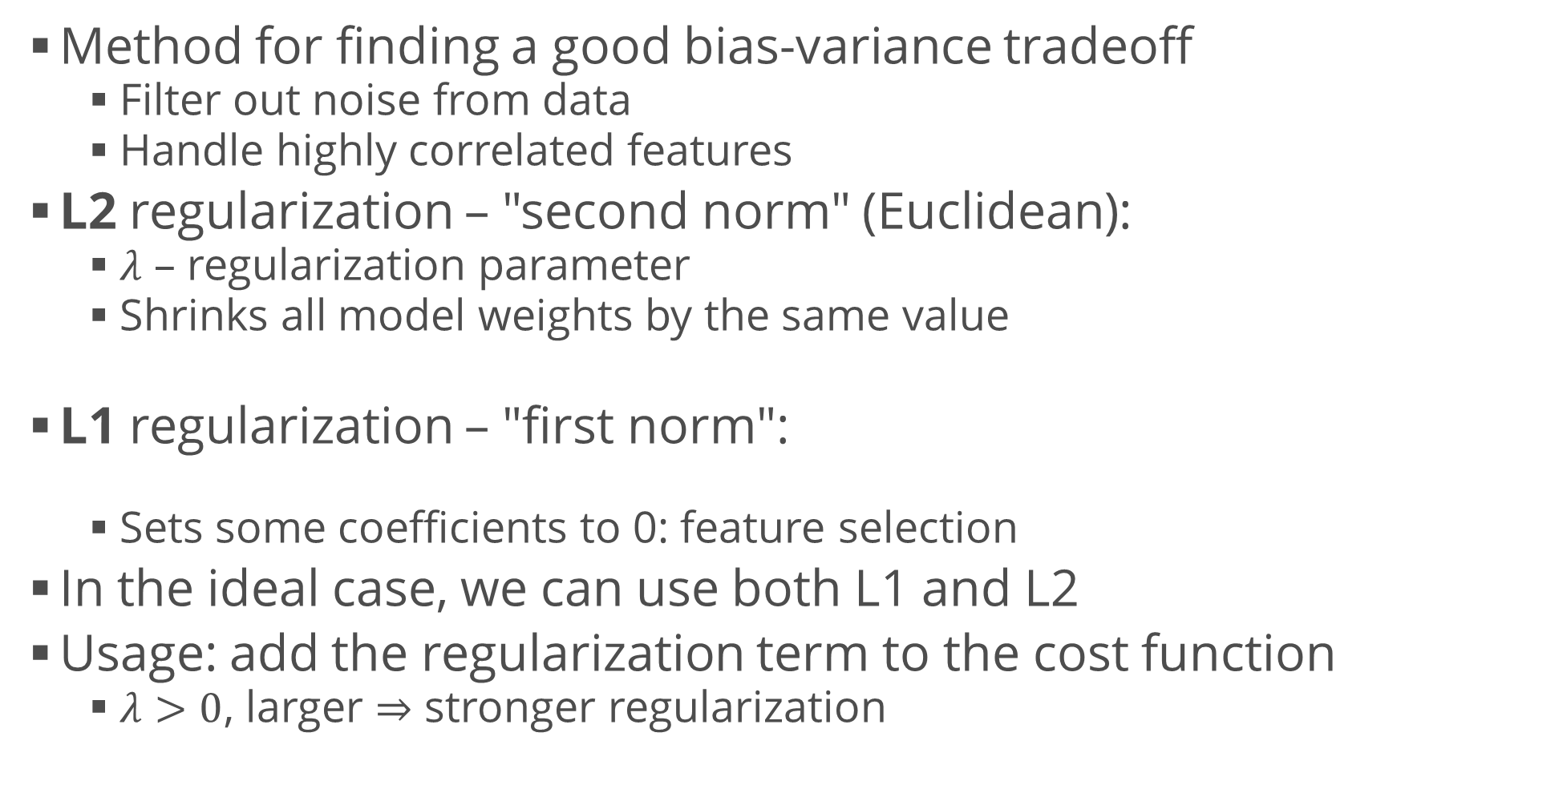
Regularization
Method for finding a good bias-variance tradeoff
Filter out noise from data
Handle highly correlated features
L2 regularization – "second norm" (Euclidean):
$λ$ – regularization parameter
Shrinks all model weights by the same value
L1 regularization – "first norm":
Sets some coefficients to 0: feature selection
In the ideal case, we can use both L1 and L2
Usage: add the regularization term to the cost function
$λ>0$, larger $⇒$ stronger regularization

Slide 9
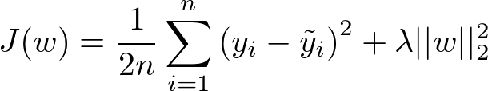
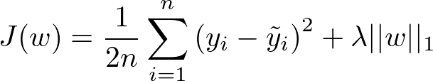
Linear Regression with Regularization
Ridge regression – L2
Cost function:
LASSO (Least Absolute Shrinkage and Selection Operator) – L1
Cost function:
Elastic Net
Has both regularization terms
from sklearn.linear_model import Ridge
model = Ridge(alpha = 0.01)
from sklearn.linear_model import Lasso
model = Lasso(alpha = 0.01)
from sklearn.linear_model import ElasticNet
model = ElasticNet(alpha = 1.0, l1_ratio = 0.5)

Slide 10
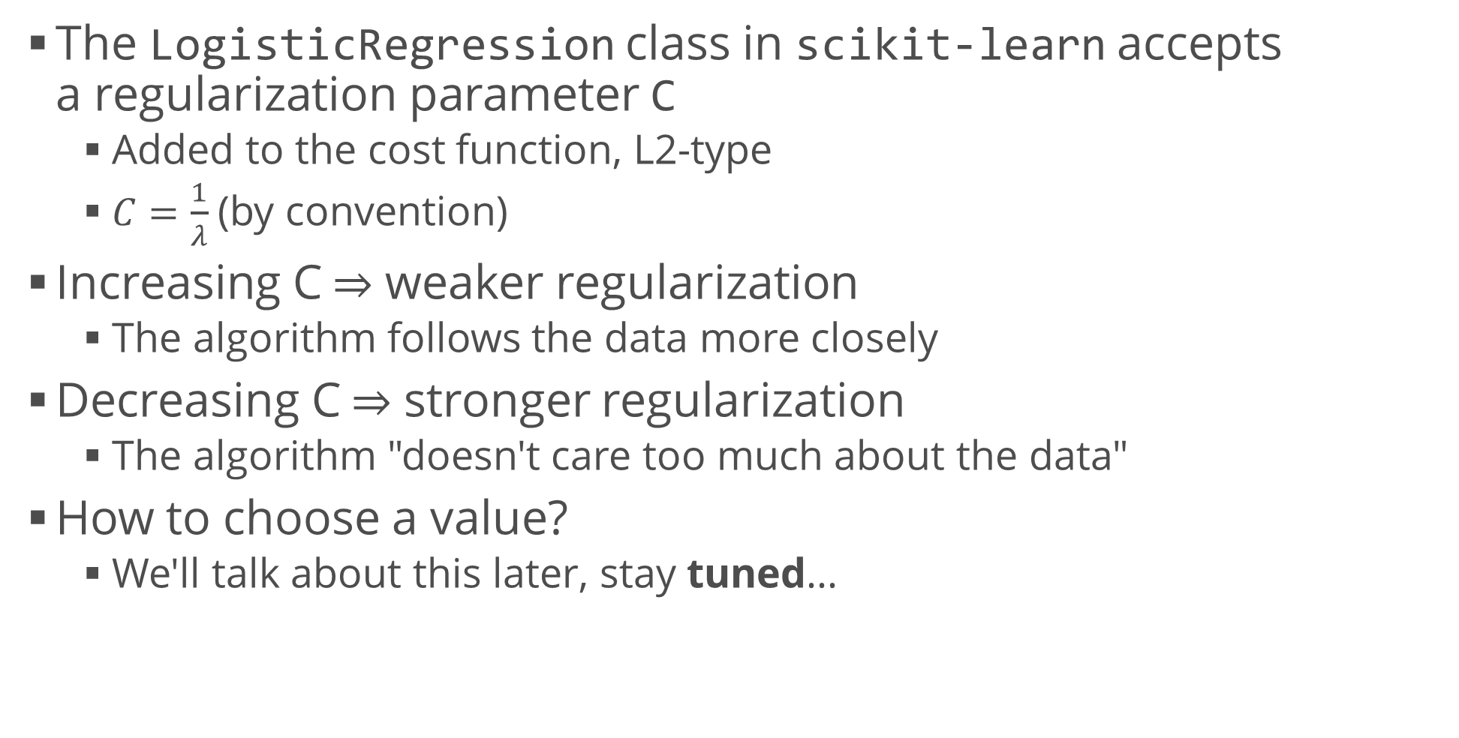
Logistic Regression with Regularization
The LogisticRegression class in scikit-learn accepts a regularization parameter C
Added to the cost function, L2-type
$C=\frac{1}{λ}$(by convention)
Increasing C $⇒$ weaker regularization
The algorithm follows the data more closely
Decreasing C $⇒$ stronger regularization
The algorithm "doesn't care too much about the data"
How to choose a value?
We'll talk about this later, stay tuned…

Slide 11
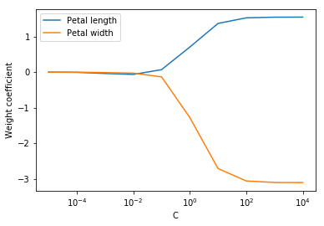
Visualizing Regularization Parameters
Perform a logistic regression on the Iris dataset with several values of C
Display the weights
Observe how decreased C leads to weight shrinking
iris = load_iris()
attributes, labels = iris.data[:, [2, 3]], iris.target
weights, params = [], []
for c in np.arange(-5, 5):
model = LogisticRegression(C = 10.0 ** c)
model.fit(attributes, labels)
weights.append(model.coef_[1]) # Display only the second class
params.append(10.0 ** c)
weights = np.array(weights)
plt.plot(params, weights[:, 0], label = "Petal length")
plt.plot(params, weights[:, 1], label = "Petal width")
plt.xlabel("C")
plt.ylabel("Weight coefficient")
plt.xscale("log")
plt.legend()
plt.show()

Slide 12
Model Testing
Seeing how well your model performs on new data

Slide 13
Training and Testing Sets
One of the most important rules in machine learning is
NEVER test the model with the data you trained it on!
The model may "cheat" and learn the answers instead of finding structure in the data
Since we usually have one dataset, it's useful to "hold out" some of the data for testing
Usually 70% of the data is for training and 30% – for testing
We need to take randomized samples
In cases of classification, we need stratified samples
scikit-learn has a convenient method for this
from sklearn.model_selection import train_test_split
attr_train, attr_test, l_train, l_test = train_test_split(attributes, labels, train_size = 0.7)

Slide 14
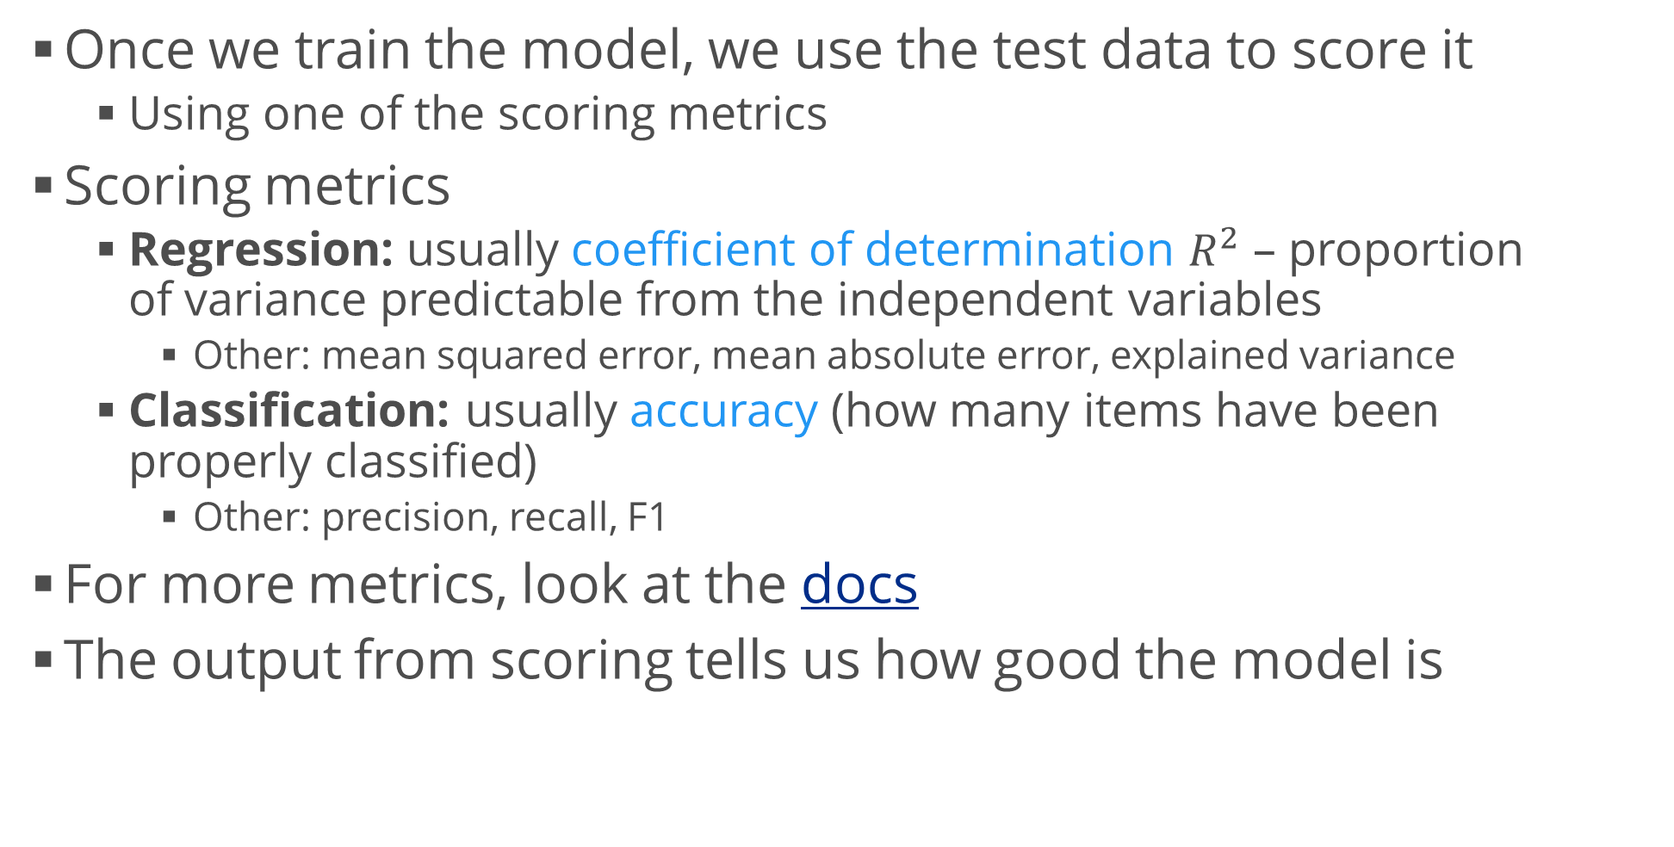
Evaluating Model Performance
Once we train the model, we use the test data to score it
Using one of the scoring metrics
Scoring metrics
Regression: usually coefficient of determination $R^{2}$ – proportion of variance predictable from the independent variables
Other: mean squared error, mean absolute error, explained variance
Classification: usually accuracy (how many items have been properly classified)
Other: precision, recall, F1
For more metrics, look at the docs
The output from scoring tells us how good the model is

Slide 15
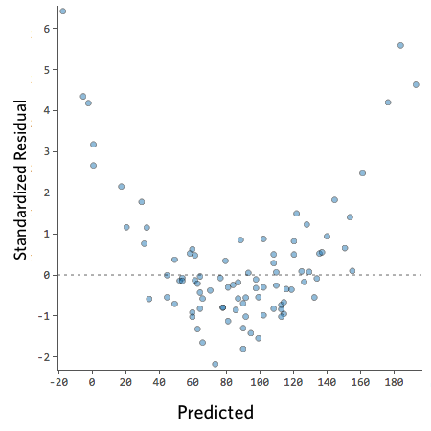
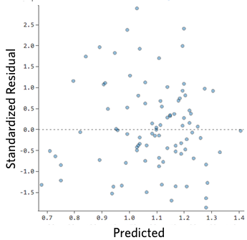
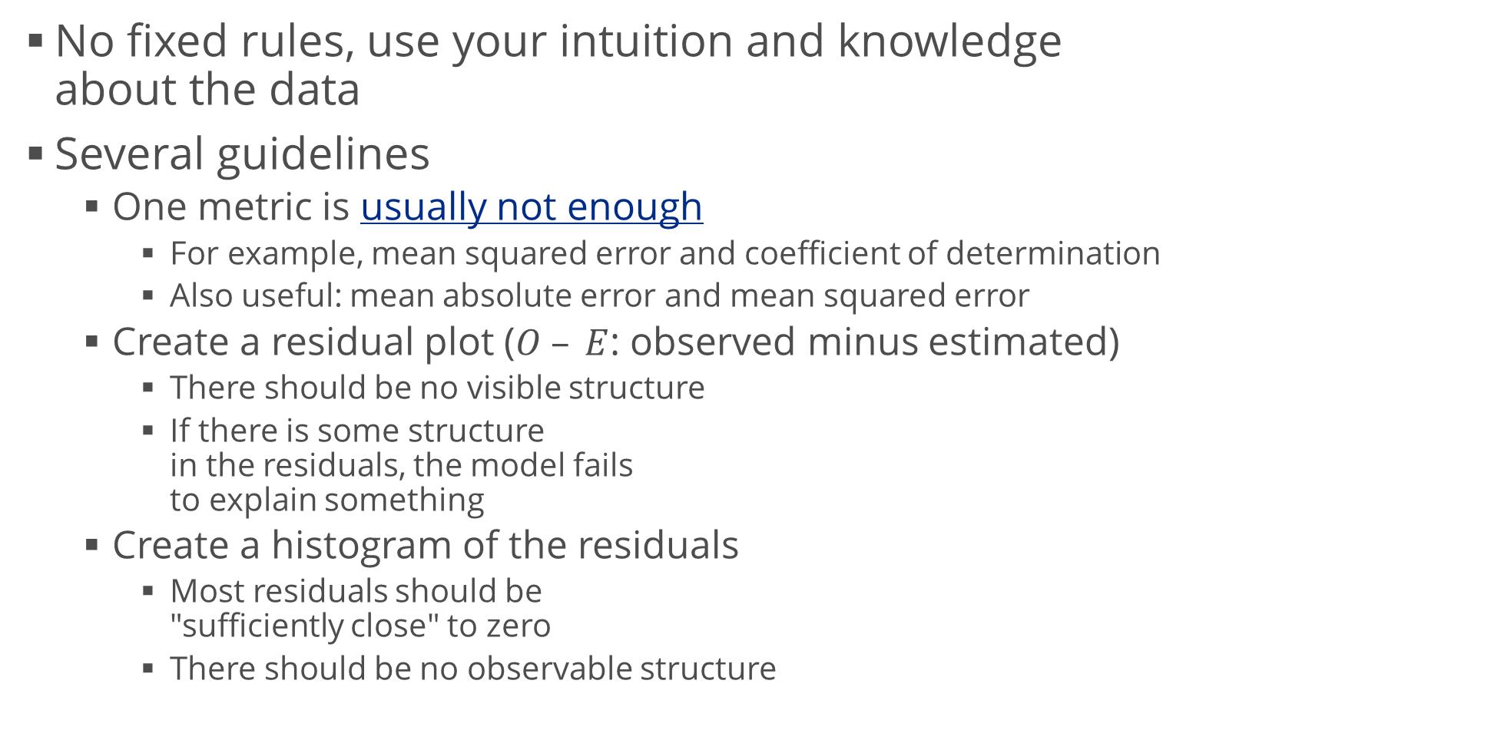
Evaluating Regression
No fixed rules, use your intuition and knowledge about the data
Several guidelines
One metric is usually not enough
For example, mean squared error and coefficient of determination
Also useful: mean absolute error and mean squared error
Create a residual plot ($O – E$: observed minus estimated)
There should be no visible structure
If there is some structure in the residuals, the model fails to explain something
Create a histogram of the residuals
Most residuals should be "sufficiently close" to zero
There should be no observable structure

Slide 16
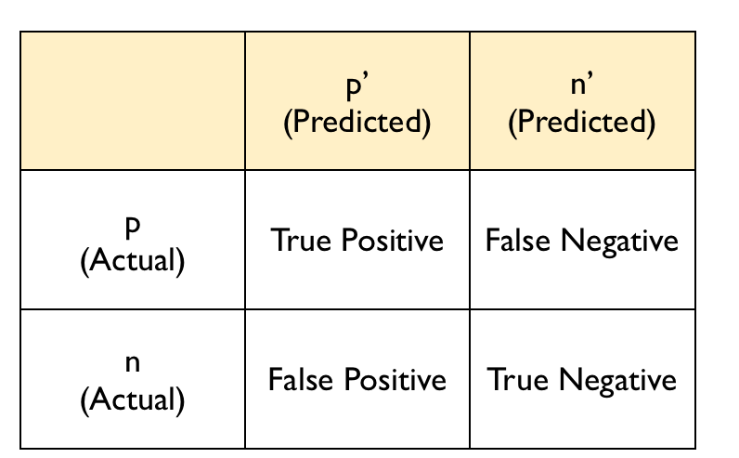
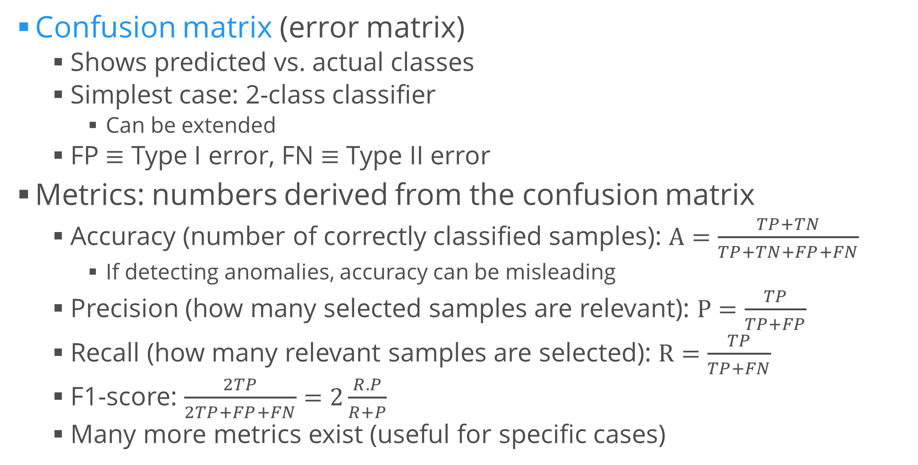
Evaluating Classification
Confusion matrix (error matrix)
Shows predicted vs. actual classes
Simplest case: 2-class classifier
Can be extended
FP $≡$ Type I error, FN $≡$ Type II error
Metrics: numbers derived from the confusion matrix
Accuracy (number of correctly classified samples): $A=\frac{TP+TN}{TP+TN+FP+FN}$
If detecting anomalies, accuracy can be misleading
Precision (how many selected samples are relevant): $P=\frac{TP}{TP+FP}$
Recall (how many relevant samples are selected): $R=\frac{TP}{TP+FN}$
F1-score: $\frac{2TP}{2TP+FP+FN}=2\frac{R.P}{R+P}$
Many more metrics exist (useful for specific cases)

Slide 17
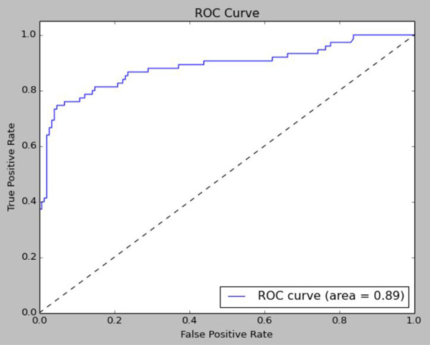
Receiver Operating Characteristic
Limited to 2-class classification
We can use "1 vs. all" for more classes
A plot of true positive rate vs. false positive rate
A "bisector line" represents truly random guessing
Any curve above the line is better than random
Closer to the upper left corner = better
Below the line: still better than random, we have to reverse the classifier output
Area under the curve (AUC): closer to 1 = better
Example in scikit-learn

Slide 18
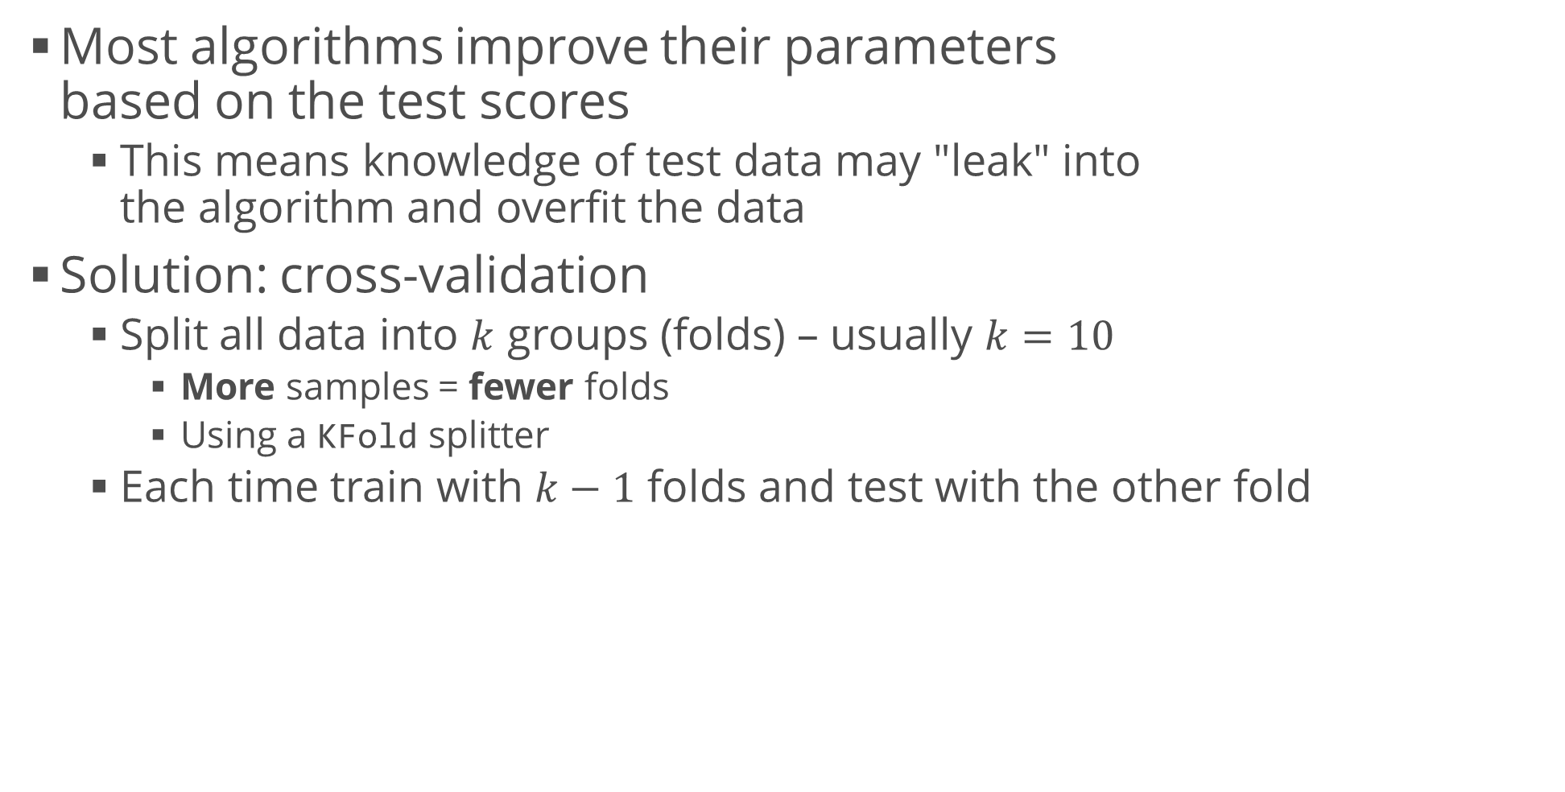
Cross-Validation
Most algorithms improve their parameters based on the test scores
This means knowledge of test data may "leak" into the algorithm and overfit the data
Solution: cross-validation
Split all data into $k$ groups (folds) – usually $k=10$
More samples = fewer folds
Using a KFold splitter
Each time train with $k−1$ folds and test with the other fold
from sklearn.model_selection import StratifiedKFold, cross_val_score
k_fold = StratifiedKFold(n_splits = 5)
scores = cross_val_score(model, attributes, labels, cv = k_fold)

Slide 19
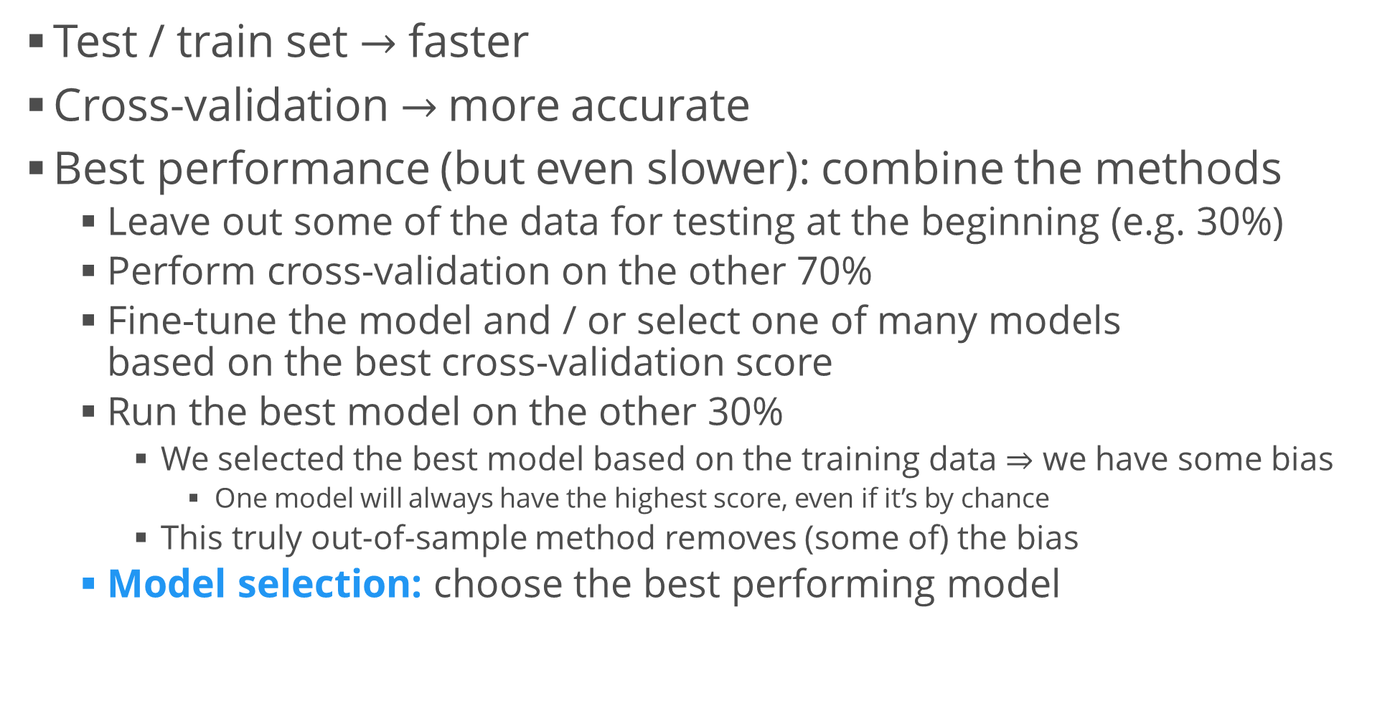
Improved Technique
Test / train set $→$ faster
Cross-validation $→$ more accurate
Best performance (but even slower): combine the methods
Leave out some of the data for testing at the beginning (e.g. 30%)
Perform cross-validation on the other 70%
Fine-tune the model and / or select one of many models based on the best cross-validation score
Run the best model on the other 30%
We selected the best model based on the training data $⇒$ we have some bias
One model will always have the highest score, even if it’s by chance
This truly out-of-sample method removes (some of) the bias
Model selection: choose the best performing model

Slide 20
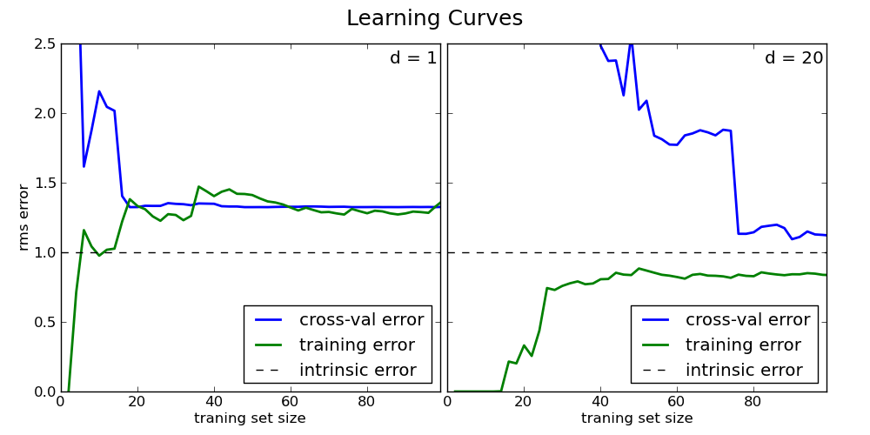
Learning and Validation Curves
Plots which allow us to diagnose bias and variance problems
Some metric (e.g. accuracy) vs. a model parameter (e.g. sample size)
Plot two curves – for the training and validation data
High bias – accuracy for training and validation is too low
Solution: add more model features, decrease regularization
High variance – large gap between the two curves
Solution: remove model features (preprocessing / feature selection / feature engineering, etc.), increase regularization
Tutorial (scikit-learn)

Slide 21
Hyperparameter Tuning
Techniques for choosing the best model hyperparameters
Such as regularization
Most widely used: grid search
"Brute-force": specify parameters; run models with all possible parameter combinations; choose the best model
Randomized search – each setting is sampled randomly from a parameter range
Faster but not guaranteed to produce the best results
from sklearn.model_selection import GridSearchCV
tuned_params = [{"C": [0.001, 0.01, 0.1, 1, 10, 100, 1000], "penalty": ["l1", "l2"]}]
grid = GridSearchCV(LogisticRegression(), tuned_params)
grid.fit(attr_train, l_train)
print(grid.best_params_) # Estimator: grid.best_estimator_

Slide 22
Making the Best of Our Models
Usually we don't know right away which algorithm will perform the best
We select several algorithms (e.g. for classification)
Fine-tune their parameters using grid search (or some other technique)
Select the best combination of parameters
After that, we compare the best algorithms from each type
Using the model selection procedure
Hold-out set + cross-validation set
Select the best performing model type on the cross-validation set
Test it on the "hold-out" set
Improvements: perform test / train split on the hyperparameter tuning step; use different performance scores

Slide 23
Manipulating Features
Making things simpler

Slide 24
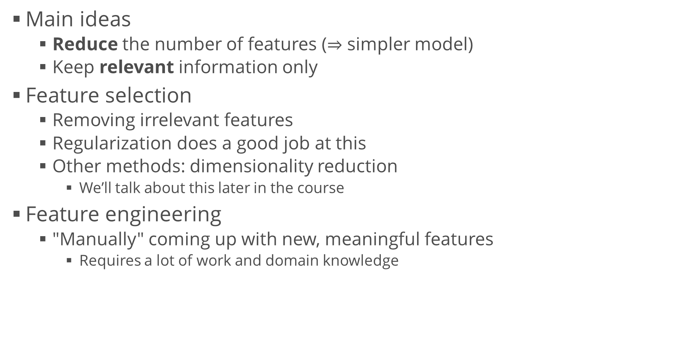
Guidelines for Manipulating Features
Main ideas
Reduce the number of features ($⇒$ simpler model)
Keep relevant information only
Feature selection
Removing irrelevant features
Regularization does a good job at this
Other methods: dimensionality reduction
We’ll talk about this later in the course
Feature engineering
"Manually" coming up with new, meaningful features
Requires a lot of work and domain knowledge

Slide 25
Summary
Bias – variance tradeoff
Applying regularization
Training and testing
Cross-validation
Model tuning and selection
Feature selection, feature engineering

